Slide 1
Barcode Database Initial Design & Concepts
Jeremy Yao, Samiul Islam

Slide 2
Problem Definition
Create a program that can store and classify barcodes
Develop code in a collaborative setting
Use a VCS

Slide 3
Objectives and Specs
Barcodes shall be stored inside of a file, database, or a spreadsheet
Items will be stored inside of a .csv file
Classification of items
Each barcode and its respective object shall be classified by user definition or auto generation
Input
For now, the user shall be able to input the barcode number string into the program.
GUI
The program will utilize JavaFX framework.
Collaboration
Communicate via Discord, use Github/Git to version control

Slide 4
Initial Design and Concepts (Jeremy)
Class hierarchies & general structure
GUI Windows
CSV Structure & Formatting

Slide 5
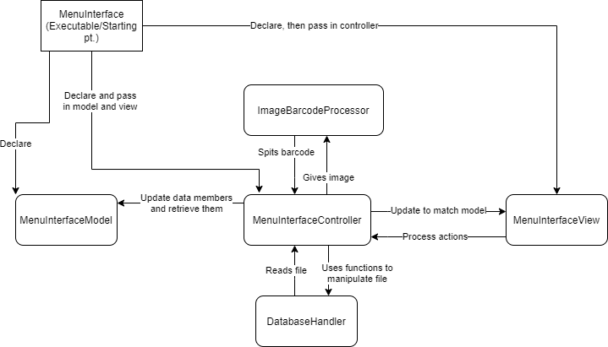


Class Heirarchy & General Structure

Slide 6
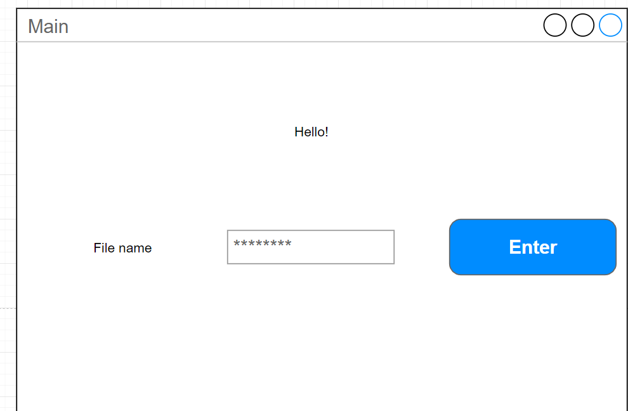
Start UI

Slide 7
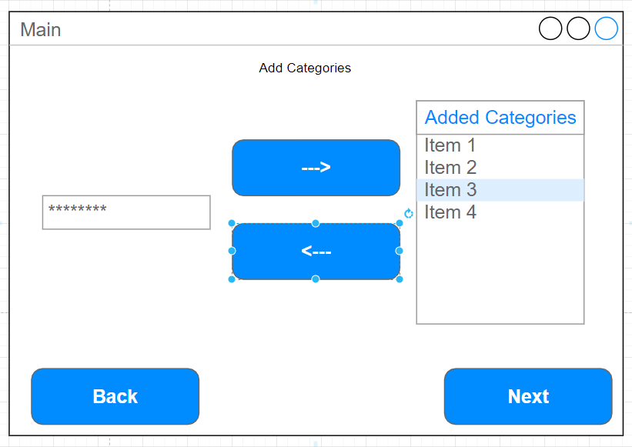
Start UI (1st Time File Setup)

Slide 8
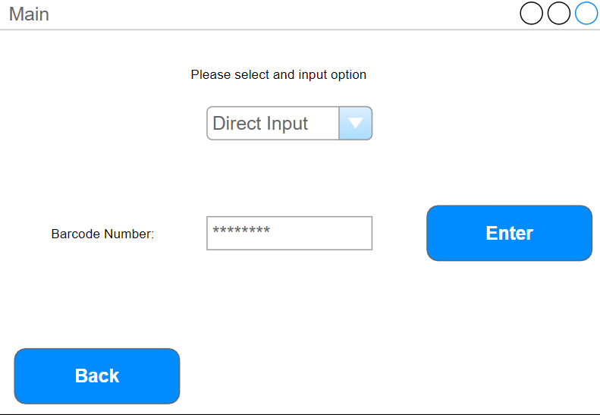
Start UI (Direct Input)

Slide 9
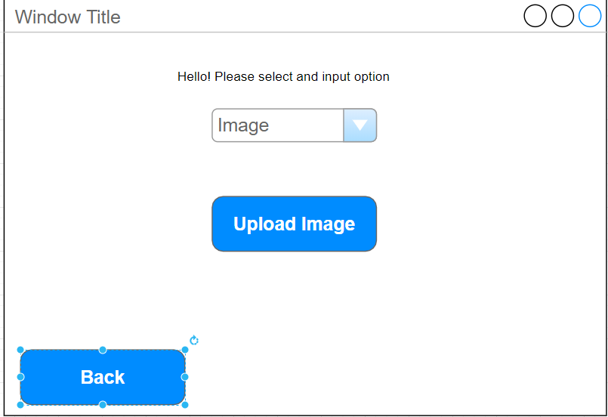
Start UI (Image)

Slide 10
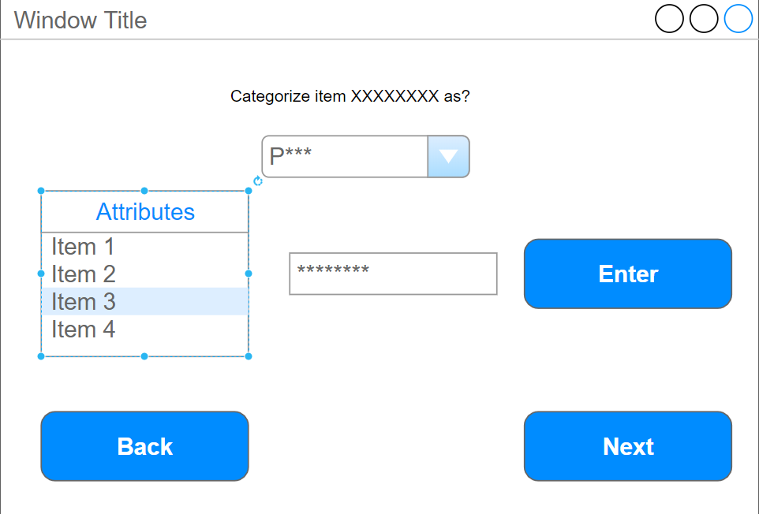

Categorization Page

Slide 11
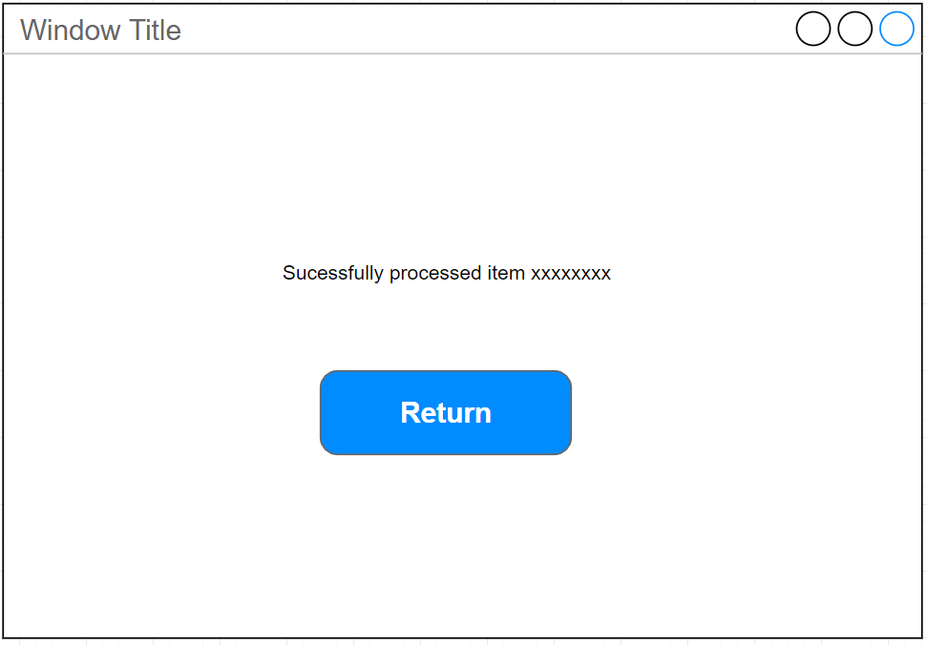
Successfully Input

Slide 12
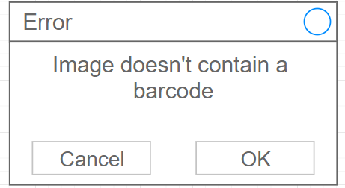
Error Window

Slide 13

CSV Formatting
Top row
Contains categories
Program should determine what categories exist from here (no 1st time setup needed if it exists)
BARCODE IS ALWAYS THE FIRST COLUMN!
Other rows
User input items

Slide 14


Slide 15
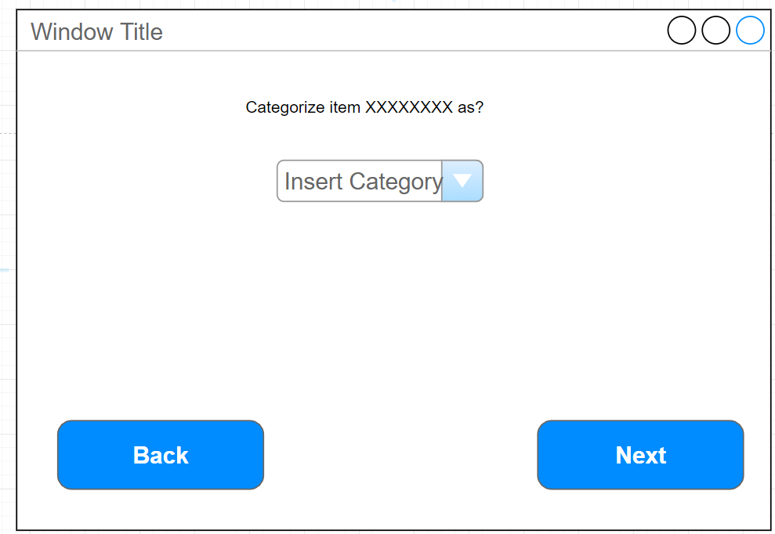
Categorization Page (Old)

